Slide 1


Slide 2
One Company, Limitless Possibilities.
Multi-divisional outsourcing solutions for business agility.

Slide 3
Who We Are?
End-to-end business solutions; including for SMBs
Flexible and affordable advice – based on thorough understanding of client business
Customized solutions to streamline operations, especially back-office, and boost productivity
Dedicated expertise and robust infrastructure to deliver rapid resolution
Proven track record of over a decade
Client retention of over 95%

Slide 4






We deliver technology driven accounting solutions covering a range of services:
Bookkeeping
Accounting
Controller
Business Analytics
CFO
Accounting Systems Integration

Slide 5
Access CPA Expertise: Whenever, Wherever
Promote Sustainable Growth, even in COVID-19 times
Empower Your Business to Stay Competitive
Assess, Understand, and Outline Your Unique Business Needs First
Customize Solutions: To Fit Your Business Needs
Benefits, Profit, and Grow from: Seamless, End-to-End Solutions

Slide 6
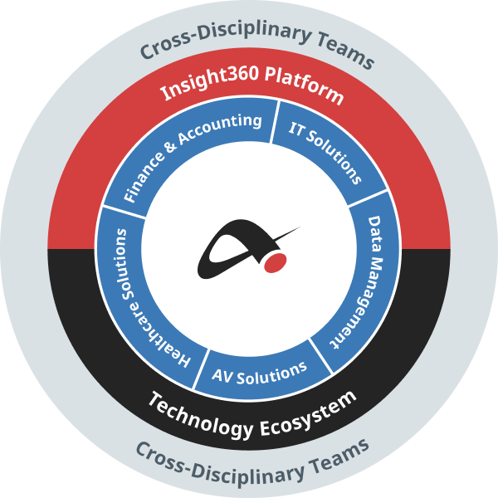
Solutions Model
Our integrated services, applications and operational tools address the specific needs of your business.

Slide 7

Custom-tailored solution for the unique business demands
and management concerns of specialized industries.

Slide 8
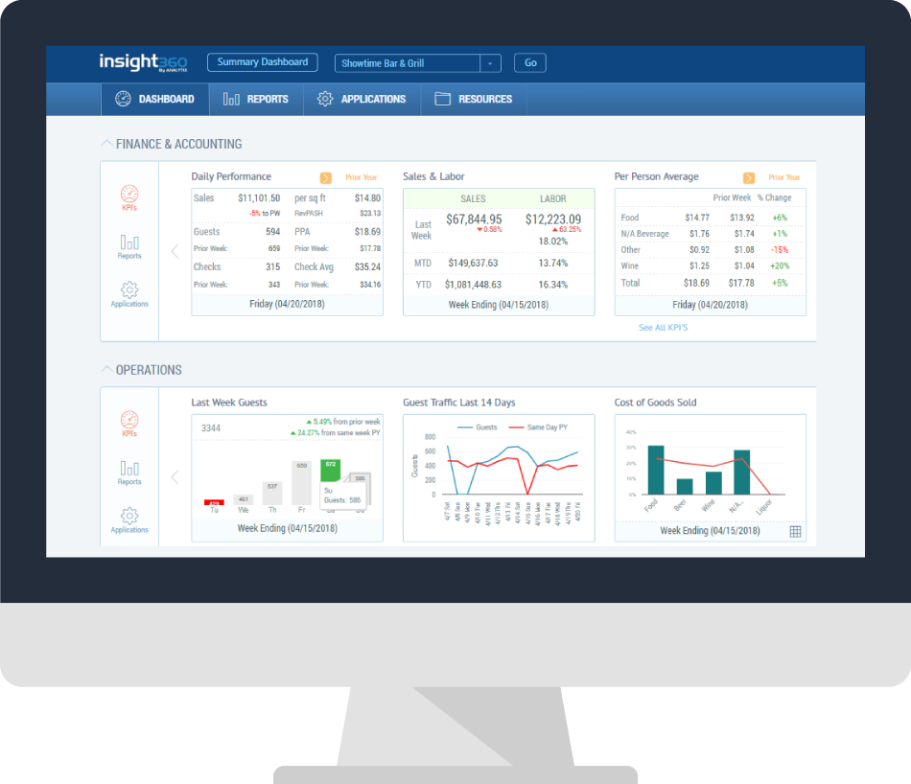
Industries Served:
Dental
Hospitality
Restaurants
DME
Audio Visual
Startup
Professional Services
Retail
Indoor Sporting Facilities
E-commerce
Franchise

Slide 9






Why Insight360
Complete accounting and bookkeeping solution - from recording vendor bills to financial statement preparation
Make your daily tasks, such as bill payment and payroll processing, fast and simple
All your sales, cost and labor data on one easy to use portal, updated daily
Only most relevant metrics and reports designed specifically for your industry
Additional tools to save time on daily tasks
Flexible packages tailored to your needs, with no long term commitment

Slide 10
Engagement Models for Partners
Referral
Private ( White ) Label
Co-Branding
Joint Venture
Our Partners
CPA Firms
Bookkeeping Firms
Consulting Firms
Part-time CFOs

Slide 11
Partnership Benefits
Expand your service and product offerings
Focus on higher margin, client-centric activities
Grow without adding overhead
Access to our technology platform, scalable infrastructure and skills set
Secured portal - Available 24/7
Cost effective business model
Partner Portal Features
Manage clients
Benchmarking
Special client reporting
Single login
Customizable
Automated onboarding

Slide 12
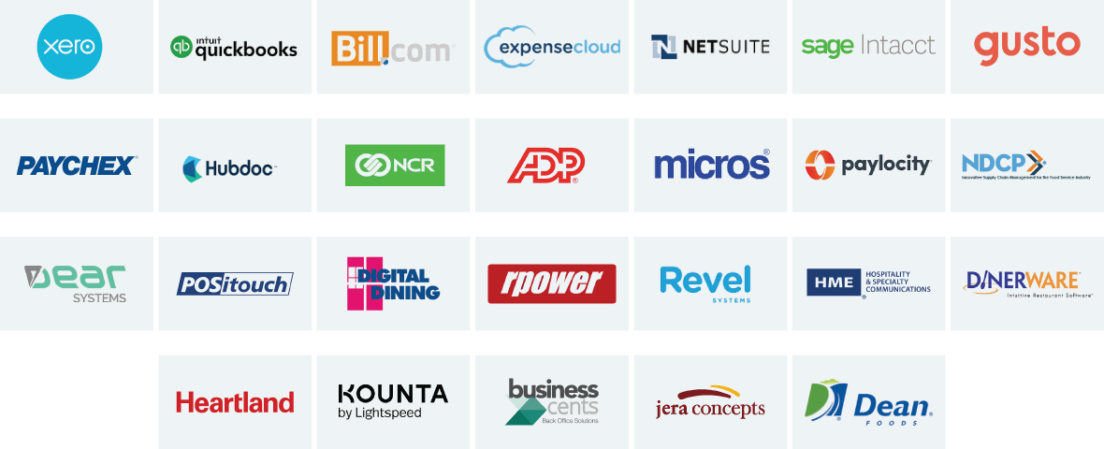
Applications We Work With

Slide 13
Finance & Accounting
IT Solutions
Insight360
Audio Visual Services
Medical Billing
Data Management
One Company
Limitless Possibilities

Slide 14
Contact us for a complimentary analysis
of your accounting system.
www.analytixaccounting.com
800 West Cummings Park, Suite 2000, Woburn, MA 01801
sales@analytix.com | 781.503.9002

